Slide 1
COVID-19 WORLD DATA ANALYSIS
Ethan Dexter Bard
Bachelor of Science, Data Analytics
Spring 2022
Florida Polytechnic University

Slide 2
Introduction
As the SARS-COV-2 virus spreads and mutates around the world, it is essential to monitor the emergence of new variants.
While countries around the world implement varying levels of disease prevention, it is critical to be able to model and forecast COVID-19 cases and other measures to anticipate if additional actions need to be taken.
The following report is an analysis of time-series data that aims to provide a framework for identifying countries struggling with COVID-19 and generate a model fit to forecast various relevant measures such as cases, deaths, and vaccination rates.

Slide 3
Objectives
Evaluate current state of SARS-COV-2 variants around the world
Identify countries currently experiencing relatively high rates of COVID-19 cases via EDA and hierarchical clustering
Model and forecast new cases, deaths, and vaccination rates in these selected countries of concern via time-series analysis

Slide 4
Data
SARS-COV-2 Variants Time-Series dataset provided by GISAID
Date (Weekly)
Variant/Lineage
Number of Sequences
Total Number of Sequences
% of Total Sequences
COVID-19 World dataset provided by Our World in Data
Date (Daily)
Location
Cases
Deaths
Vaccinations

Slide 5
Methods - EDA
Explored the current state of prevalent SARS-COV-2 variants around the world
Visualized relationship between emerging variants and how cases, deaths, and vaccination rates are affected.

Slide 6
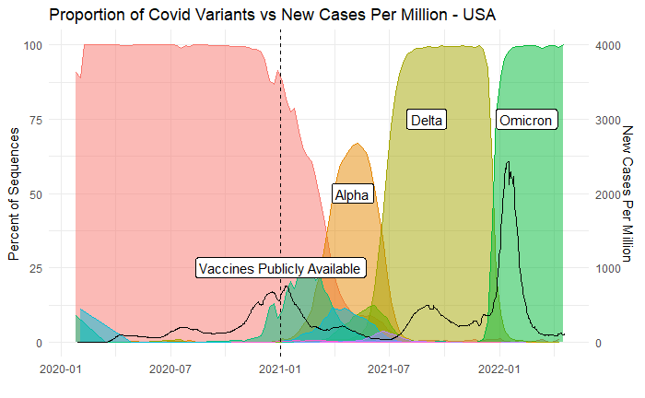
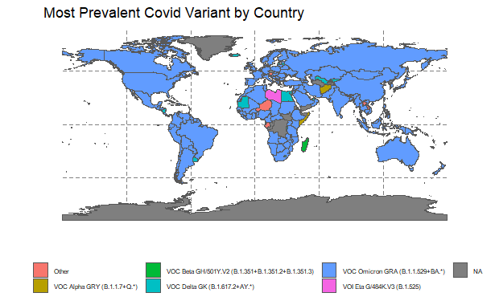
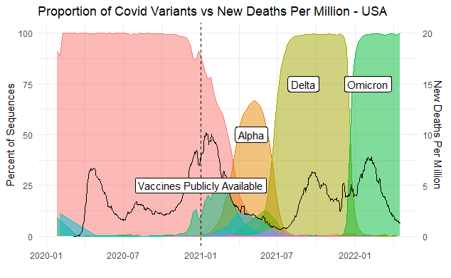
EDA

Slide 7
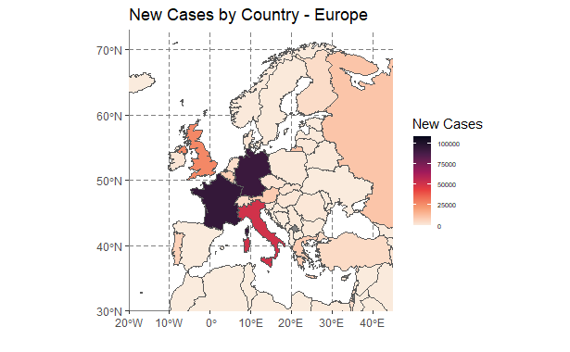
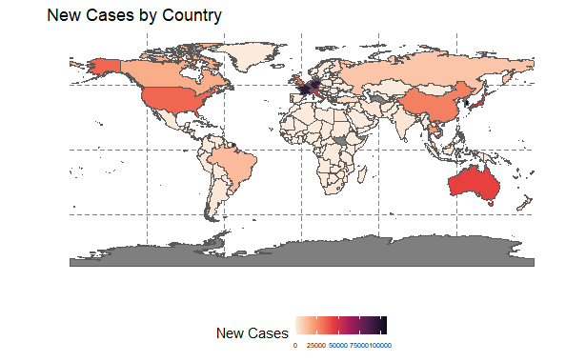
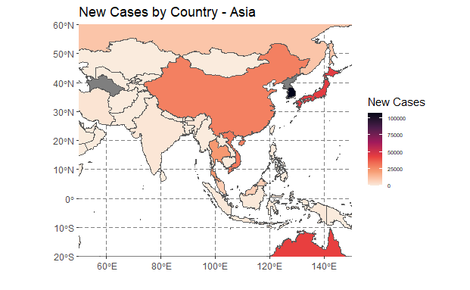
EDA

Slide 8
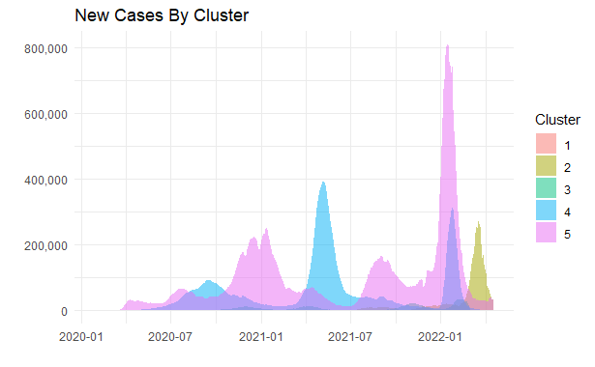
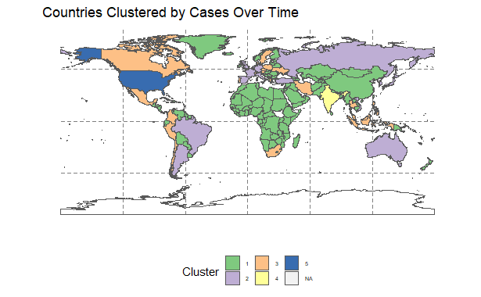
Hierarchical Clustering
5 Clusters assigned generally by similarity between average number of cases, and severity of the large spike caused by emerging variants.

Slide 9
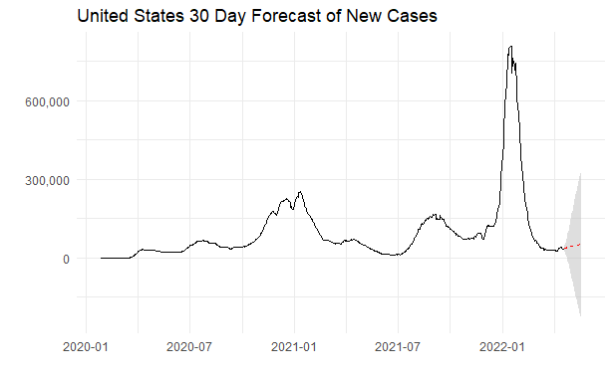
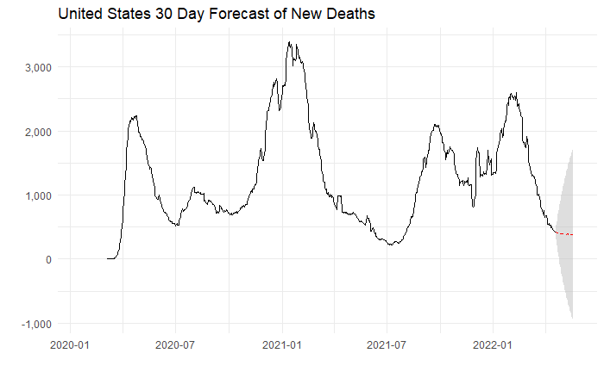
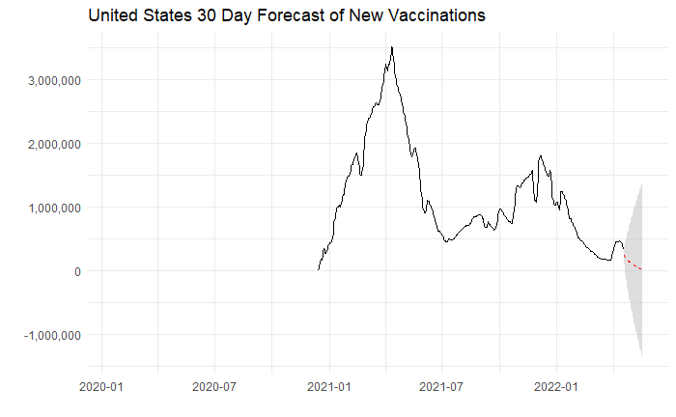
ARIMA Time-Series
Selected key countries that appear to be experiencing high rates of COVID-19 based on EDA and cluster assignment
ARIMA models fit to forecast cases, deaths, and vaccination rates.

Slide 10
ARIMA Time-Series
New Cases Smoothed
Country | ARIMA Parameters Selected | RMSE | AIC | BIC
USA | ARIMA(3,1,4) | 6679.878 | 16627.02 | 16664.62
India | ARIMA(2,1,2) | 918.9514 | 13284.38 | 13307.83
Austria | ARIMA(3,1,2) | 511.0791 | 11941.56 | 11969.51
France | ARIMA(0,1,2) | 4243.799 | 15519.13 | 15537.93
Germany | ARIMA(1,1,3) | 3506.469 | 15478.13 | 15506.19
Italy | ARIMA(1,1,5) | 1156.712 | 13624.32 | 13657.14
South Korea | ARIMA(5,1,0) | 2282.981 | 14877.66 | 14905.85
Vietnam | ARIMA(5,1,3) | 2599.927 | 15095.63 | 15137.93
China | ARIMA(4,2,0) | 251.8862 | 11189.92 | 11213.41
Thailand | ARIMA(3,1,2) | 529.6249 | 12490.8 | 12523.7
New Deaths Smoothed
Country | ARIMA Parameters Selected | RMSE | AIC | BIC
USA | ARIMA(3,1,3) | 53.42787 | 8383.43 | 8416
India | ARIMA(4,1,0) | 60.03619 | 8416.17 | 8439.36
Austria | ARIMA(3,1,3) | 1.875135 | 3117.03 | 3154.13
France | ARIMA(5,1,0) | 17.26007 | 6685.28 | 6713.3
Germany | ARIMA(3,1,4) | 9.662358 | 5648.9 | 5686.03
Italy | ARIMA(4,1,0) | 7.48404 | 5380.3 | 5403.61
South Korea | ARIMA(1,1,2) | 2.620837 | 3745.55 | 3764.21
Vietnam | ARIMA(2,1,1) | 9.721073 | 4592.07 | 4614.23
China | ARIMA(0,1,0) | 9.416997 | 5942.57 | 5947.27
Thailand | ARIMA(2,1,4) | 2.467826 | 3606.76 | 3639.32

Slide 11
ARIMA – Time Series
New Vaccinations Smoothed
Country | ARIMA Parameters Selected | RMSE | AIC | BIC
USA | ARIMA(3,2,3) | 30995.25 | 11520.27 | 11549.62
India | ARIMA(1,1,2) | 405639.9 | 13137.55 | 13154.06
Austria | ARIMA(1,1,0) | 683.1586 | 7332.58 | 7340.85
France | ARIMA(1,1,0) | 10990.78 | 10214.58 | 10222.91
Germany | ARIMA(5,1,2) | 13811.06 | 10467.2 | 10500.54
Italy | ARIMA(3,2,3) | 7705.306 | 9891.11 | 9920.26
South Korea | ARIMA(2,1,5) | 22381.55 | 9534.2 | 9566.45
China | ARIMA(1,1,0) | 213859 | 13369.53 | 13377.91
Thailand | ARIMA(2,1,3) | 22401.21 | 9506.22 | 9530.39

Slide 12
Conclusions
No sign of any emerging variants of concern, Omicron is still the most prevalent in virtually all countries with current data.
Of the selected countries with relatively high numbers of recent cases, they all seem to be on the decline along with deaths and vaccinations.
This framework can be easily reproduced as new data comes in, and could potentially predict a surge of new cases if one were to occur.

